Slide 1
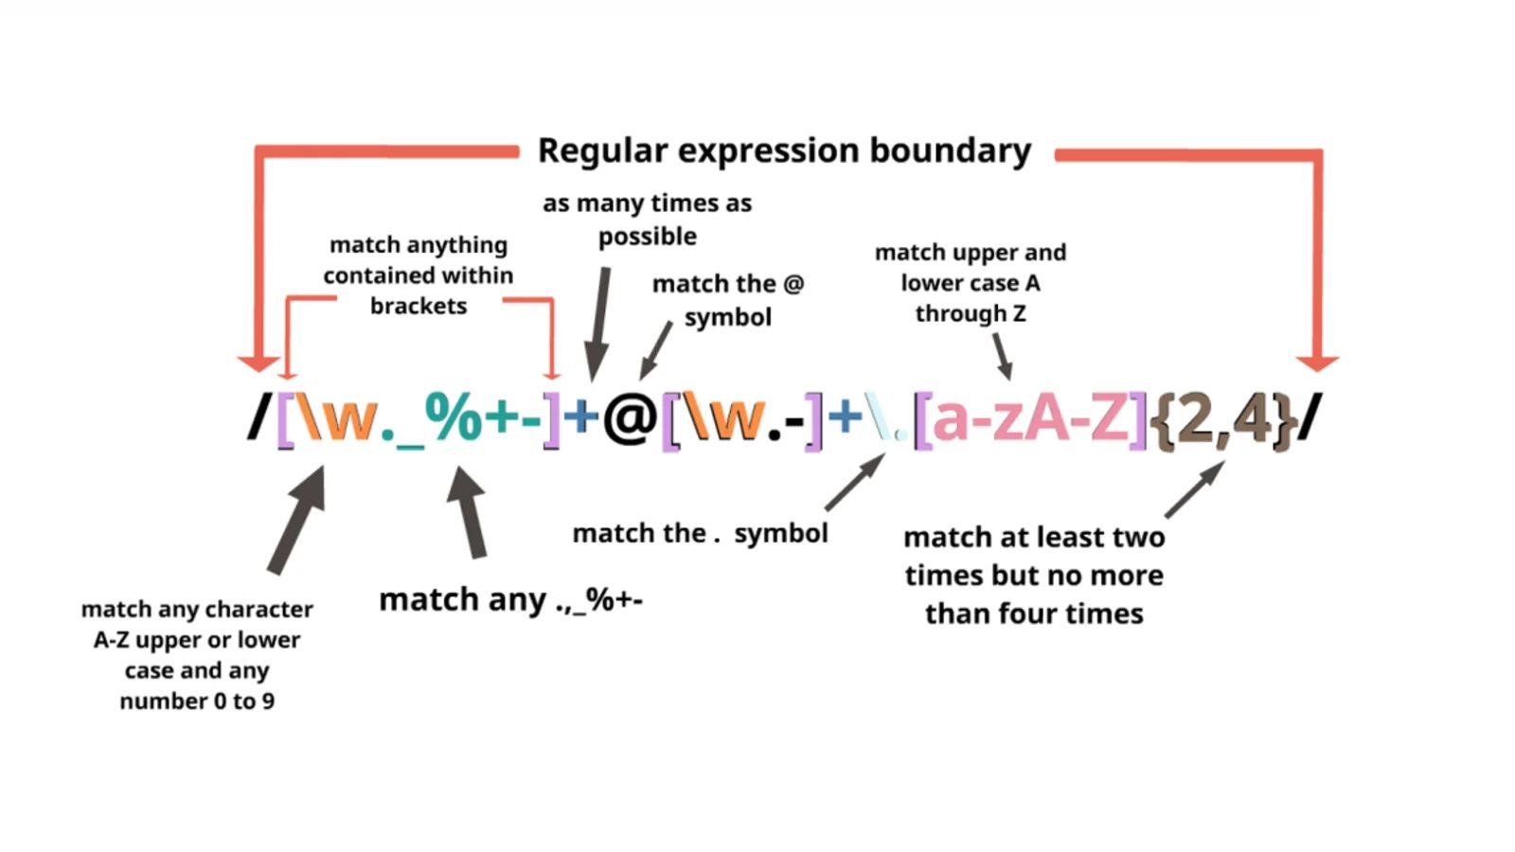
Regular Expressions A string to find another string
Miklós Csuvár
ex nuclear safety inspector

Slide 2

CONTENTS
Introduction
History, design
Syntax
Code examples
RegExp integration in applications and programming
Personal experience
Education tools
Resources
Summary
Notes:
Know more in the subject than your peers know, they will ask questions
Set the scene, add context, explain why is this topic is interesting
How it fits to existing topic? What's the connection to already learned subjects?
Is there a typical use-case for the subject you present?
Add references, screenshots and diagrams to underpin your talk
Be precise, to the point, but don't exaggerate in detail
Show code examples as much as possible
At the end, summarize what you just talked about
Add a page with links to your resources where anyone can learn more

Slide 3
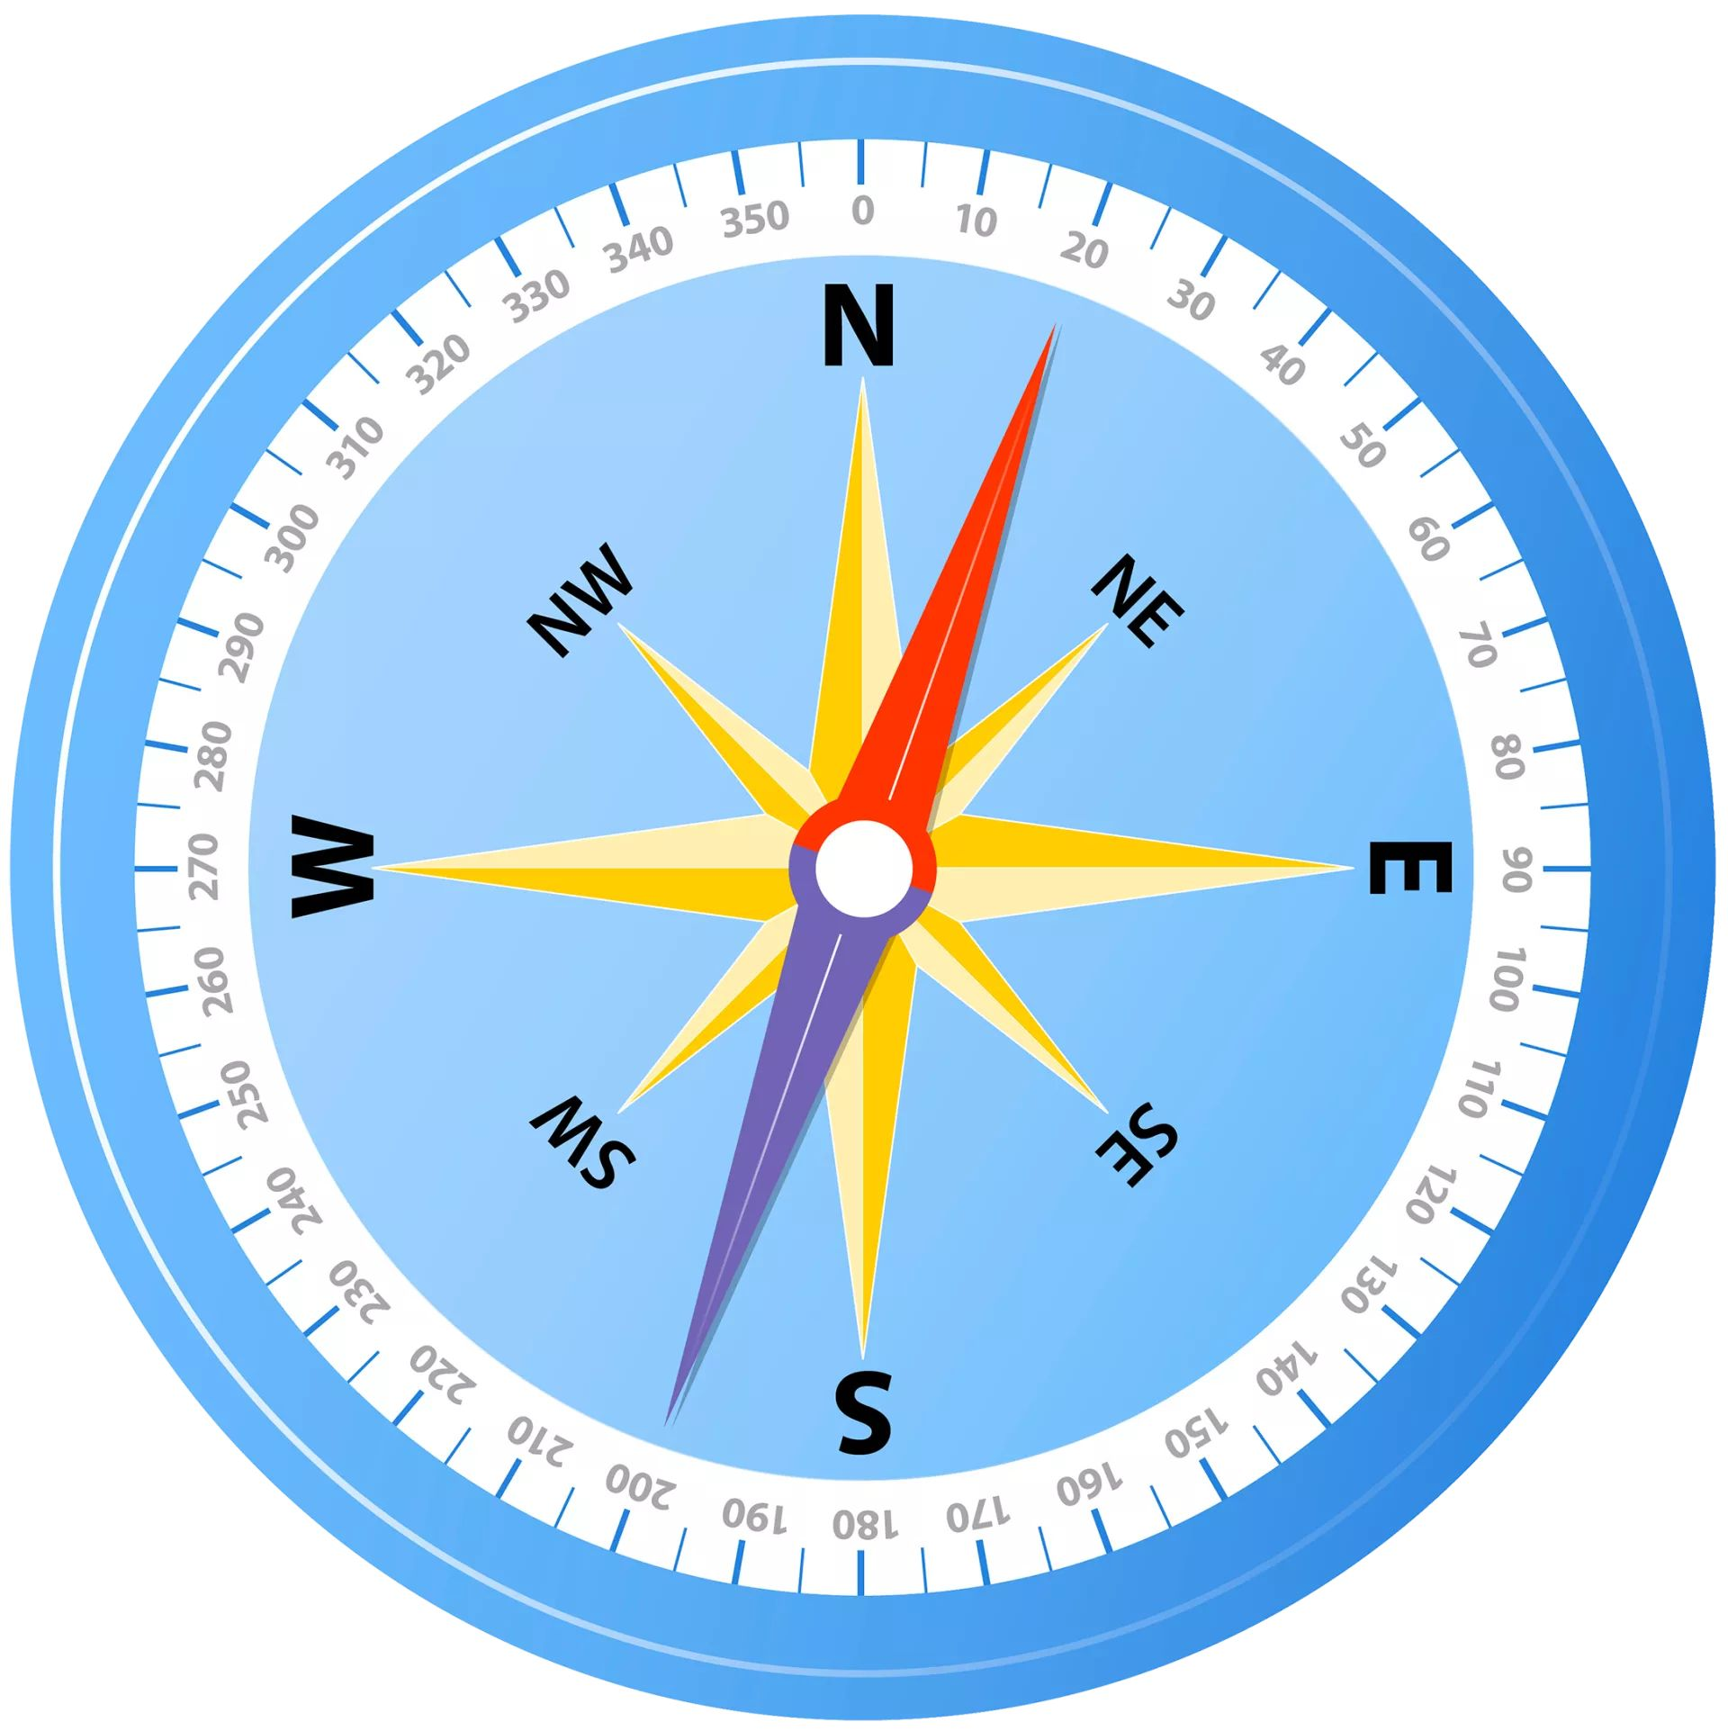
1. Introduction
What?
Regex or regexp
A sequence of characters coding a pattern to find.
Why?
Demand originally from theorethical computer science
Find character sequences matching a pattern
String-searching algorithms for "find" or "find and replace " and input validation.
Where? (Connections)
Web scraping
Big data
Compilers
Notes:
A regular expression (shortened as regex or regexp; sometimes referred to as rational expression) is a sequence of characters that specifies a match pattern in text. Usually such patterns are used by string-searching algorithms for "find" or "find and replace" operations on strings, or for input validation. Regular expression techniques are developed in theoretical computer science and formal language theory.
Regex is used widely used in:
Web scraping
Big data
Compilers

Slide 4

2. History, design
1951: Invented by Stephen Cole Kleene
1968: Ken Thompson
Pattern matching in a text editor: QED -> ed -> grep
Lexical analysis in a compiler.
1970s: Integration into:
Unix programs at Bell Labs: vi, lex, sed, AWK, expr.
Emacs by Richard Matthew Stallman
1980s: Regex in Perl.
1997: PCRE by Philip Hazel -> PHP and Apache HTTP Server
2010s: FPGA, GPU based PCRE compatible regex engines
Today: Libraries for Java, Python, C, C++, etc.
Notes:
1951: The regular expression was invented in 1951 by Stephen Cole Kleene for purely theorethical purpos: to examine if a language in theorethical computer science fits the requirements of regular language.
1968: In the revolutionary year Ken Thompson built it in to the Quick Editor, that was used for ed editor and from where is was transferred to grep application in Unix. Thompson used the regex in his compiler for lexical analysis.
1970s: The regex matures much and grown into many applications like vi etc. under the umberella of the Bell Laboratories. At this time Richard Matthew Stallman integrated regex into Emacs text editor, but with incompatible syntax.
1980s: A huge boom occured when regex was built and its use evolved greatly in Perl programming language.
1997: The next huge jump was when Philip Hazel created the Perl Compatible Regular Expression library that expanded and expanded and is widely concidered today as the best regex toolkit. This was later built in PHP and Apache HTTP Server.
2010s: In the 2010s even special, FPGA or GPU based hardwares were designed just to carry out regex searches.
Today: Today regex libraries are available for al major programming languages, like Java, Python, C, C++.

Slide 5
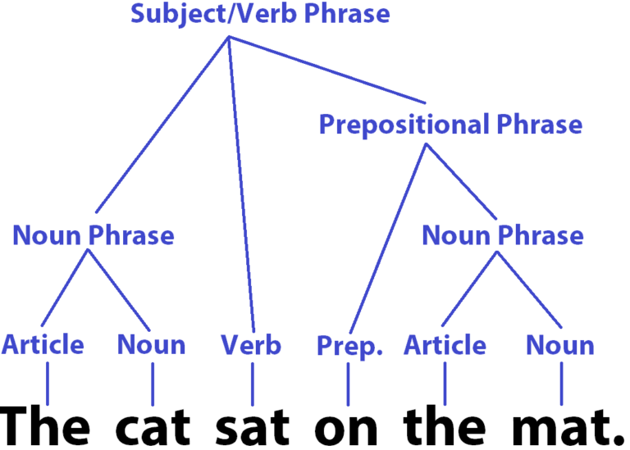
3. Syntax
metacharacter | meaning | metacharacter | meaning
. | Any single character | * | Matches the preceeding element … times: t >= 0
[ ] | Logical OR for the char.s within: [ABC] | {m} | == m: a{3}
[^ ] | None of the char.s within: [^ABC] | {m,} | t >= m: b{4,}
^ | Begins with:^A | {m,n} | m<= t <= n: c{5,7}
$ | Ends with: t$ | {,n} | t <= n (only PCRE): d{,8}
() | Sub-expression: (mic) | ? | 0 <= t <= 1 (only PCRE): q?
- | Range specifier: [b-pT-Z] | + | 1 <= t (only PCRE): r+
\ | Escape character: „\.” | | | Alternation (only PCRE): (cap|rat)
Notes:
There are two schools of regex schools:
POSIX (Portable Operating System Interface for uniX)
PCRE (Perl Compatible Regular Expression)
This slide is a quick overveiw into the regex metacharacters and their use and it show that already here, at the most basic level there is a difference among them that make them incompatible. At least PCRE can not be used under Unix directly, without transformation.
The PCRE indtroduced a wide range of classes and special escape characters as a superset to POSIX regex. That result in a much more readable regex code and established the overwhelming popularity of PCRE above the other.

Slide 6

4. Code examples
Regular expression | Match | No match | Regular expression | Match | No match
^[bch]at | „bat”, „cat”, „hat” | „eat”, „at” | „[0-9]{2,4}” OR „\d{2,4}” | 00, …, 99, …, 6789, etc. | 0, …, 9, 12345
[^bch]at | „eat” | „bat”, „cat”, „hat” | „[a-z]” OR „\w” | a, …, z | aa, …, zz, etc.
b\w+h$ | „bash” | „bass” | \. | „ ”, „.”, „a”, …, „z”, „A”, …, „Z”, 0, …, 9, etc.
(inflat|invas)ion | „inflation”, „invasion” | „ion” | [a-l]{3,4} | „lad”, „ill”, „deed” | „cat”

Slide 7
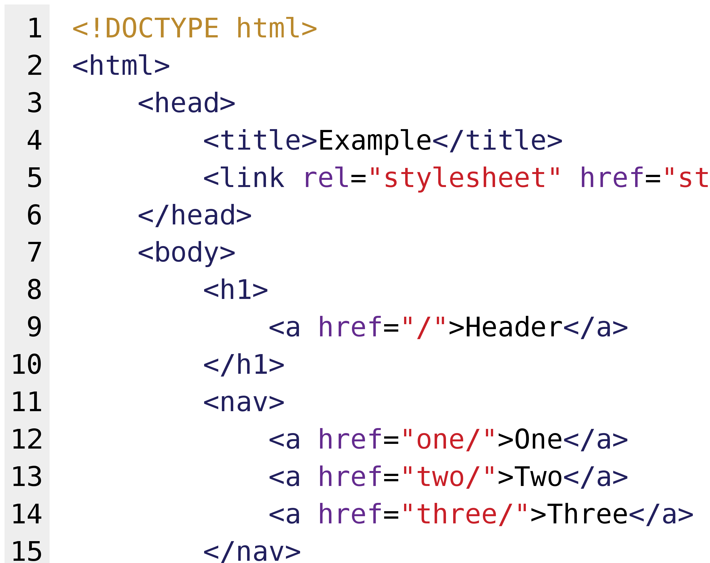
5. RegExp integration in applications and programming (1/2)
grep (in Git Bash/Bash):
$ grep --perl-regexp 'G\w+e' regex_test_text_Moby_Dick__OilPrices.txt
"194913","0.268","1","Leaded Regular Gasoline","Dollars per Gallon Including Taxes"
"197213","0.361","1","Leaded Regular Gasoline","Dollars per Gallon Including Taxes „
PowerShell/Windows Powershell
> $data = "This 1234 is 56 an 12 efficient 988765432 toolkit"
> $data -match '\d\d\d\d'
True
> $test = "123 apple 12 pear 5 corn 8764 mango 234565"
> $match = select-string "\d{2,4}" -inputobject $test
> $match.Matches.Groups[0].value
123

Slide 8
5. RegExp integration in applications and programming (2/2)
Java
import java.util.regex.Matcher; import java.util.regex.Pattern; public class Main { public static void main(String[] args) { Pattern pattern = Pattern.compile("o.+n.+to", Pattern.CASE_INSENSITIVE); Matcher matcher = pattern.matcher("To be or not to be,that is the question."); boolean matchFound = matcher.find(); System.out.println("Match found: " + matchFound); //Match found: true System.out.println("Match at index [" + matcher.start() + ", " + matcher.end() + "]"); //Match at index [1, 15) System.out.println("Match: " + matcher.group()); //Match: o be or not to } }
Notes:
The compile method’s first argument can be:
A real word, that will be compiled to regular expression by the object.
Any Perl Compatible Regular Expression.

Slide 9


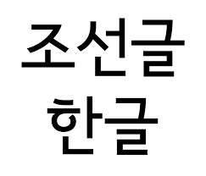




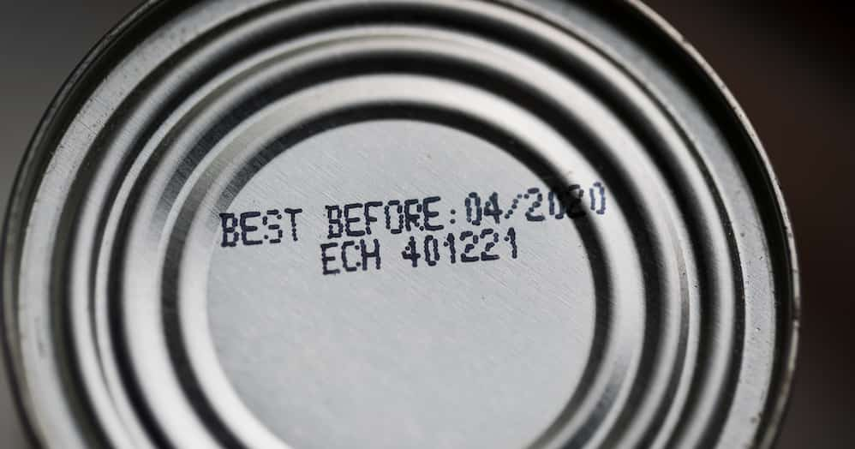

6. Personal experience
Personal use
Pros and Cons
Notes:
Personal use
Tu-22M blogpost: A colleague of mine asked me to help him by making the insertion of HTTP references of picture sources in a blog post automated. The macro was used successfully, but only once, because the „customer” was lazy to invest further time to the testing of newer macro version.
Nuclear power plant: At the beginning the new nuclear power plant licensing did not have the necessary IT support. We needed a list of nuclear related laws referred in the individual chapters of the licensing documentation. Therefore I wrote a VBA macro that collected the references.
Laws in force: Each six months the laws used by the Hungarian Atomic Energy Authority must be checked, whether they are still in force or not. This had been done a legal councelor employee clicking through cca. 210 pages in an official law website, requiring 6 hours. I invested 12 hours in a weekend after having finished a 30 lesson long Coursera Python course (Dr. Chuck). 50% was googled, 50% was written by me. By this I could compress the search from 6 hour to 6 minutes.
This case was one of the main reasons I determined my career change must be related coding.
Pros and Cons
+ The syntax of regexp is very easy to grab. A smart man can learn it in a day, like the + Hanghul according to King Sejong.
+ It compresses greatly the amount of work to find or replace huge number of findings in large text files.
+ Fortunately the toolkit is not operation system specified. Most cases PCRE is implemented as default.
- There are two standard on regexp but the later one is more versatile, overwhelmingly more used. And there is an almost total forward compatibility.

Slide 10

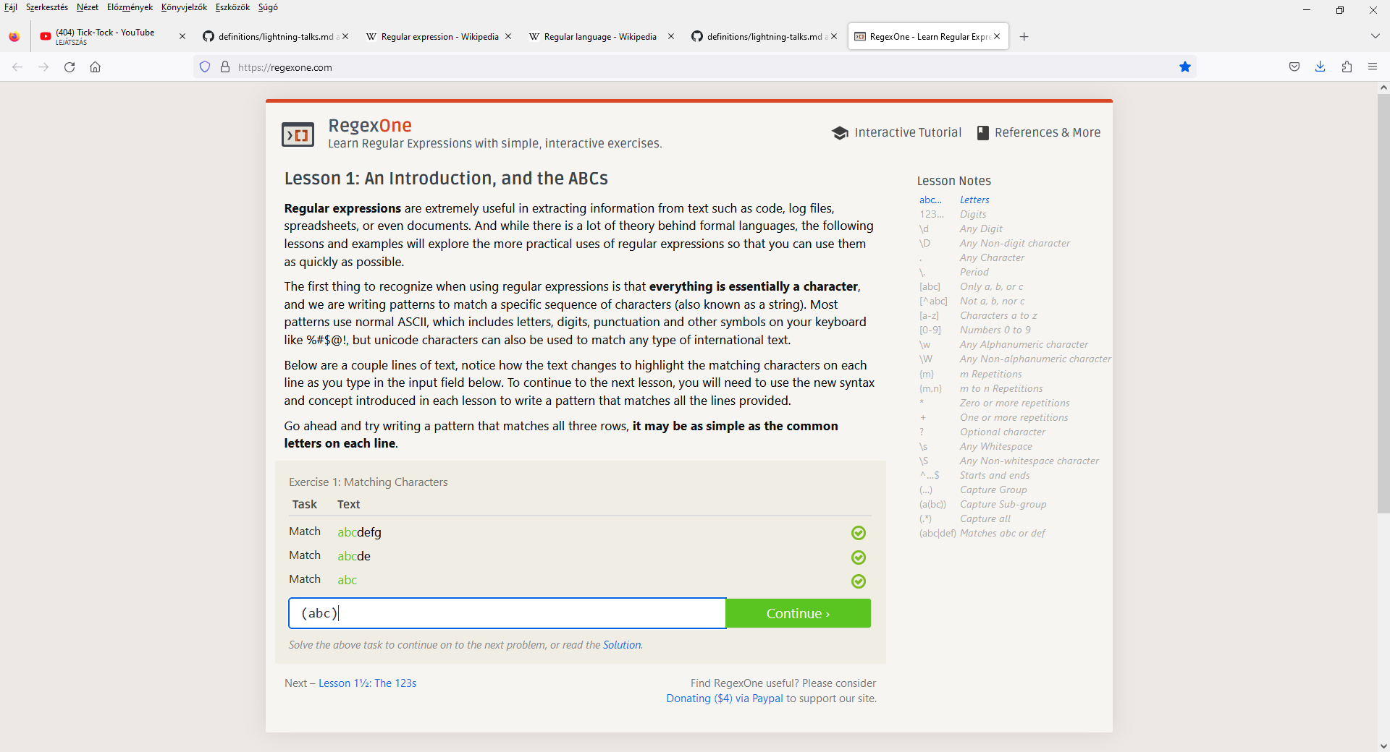
7. Education tools (1/3)
Notes:
regexone.com:
A couple of, but not many, times I had to use regular expressions at my workplace to process larger amount of data, when the IT section was not available for such individual problems. And it was always so.
I googled some web applications to train myself on regular expressions before I use it for search in Word and especially in Visual Basic macros.
I found this website the most attracting, because:
It is simple and easy to overview.
It is easy to jump to the different regex concepts to learn.
There is a cute and immediate feedback on success: BEAUTIFUL CHECK MARKS.
In this and the next 3 slides I show the regex capabilities and the weg pages’ outlike with some screenshots.
The link to this website is available under „8. Resources (1/3)” in this presentation.

Slide 11
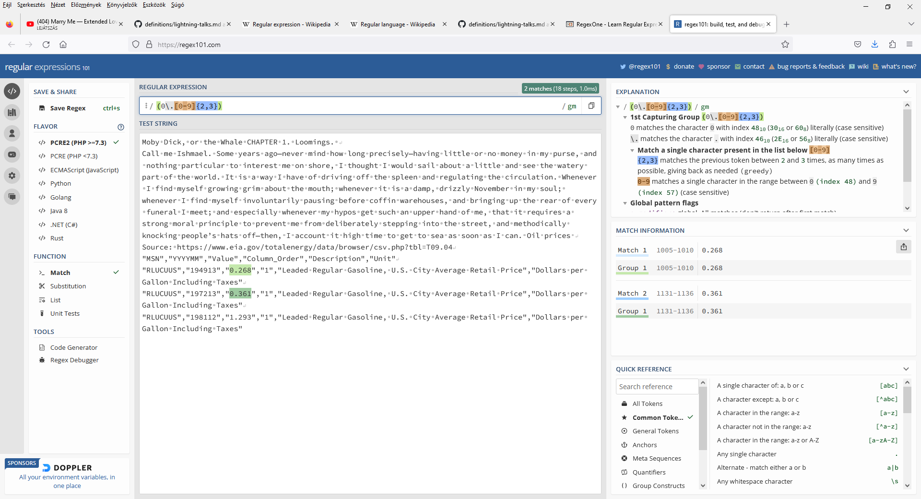
7. Education tools (2/3)
Notes:
regex101.com:
This is a very professional regex tester. Customized text tp analyze can be added. The regex pattern is explained deep in detail. The regex interpreter can be set according to various programming languages.
The link to this website is available under „8. Resources (1/3)” in this presentation.

Slide 12
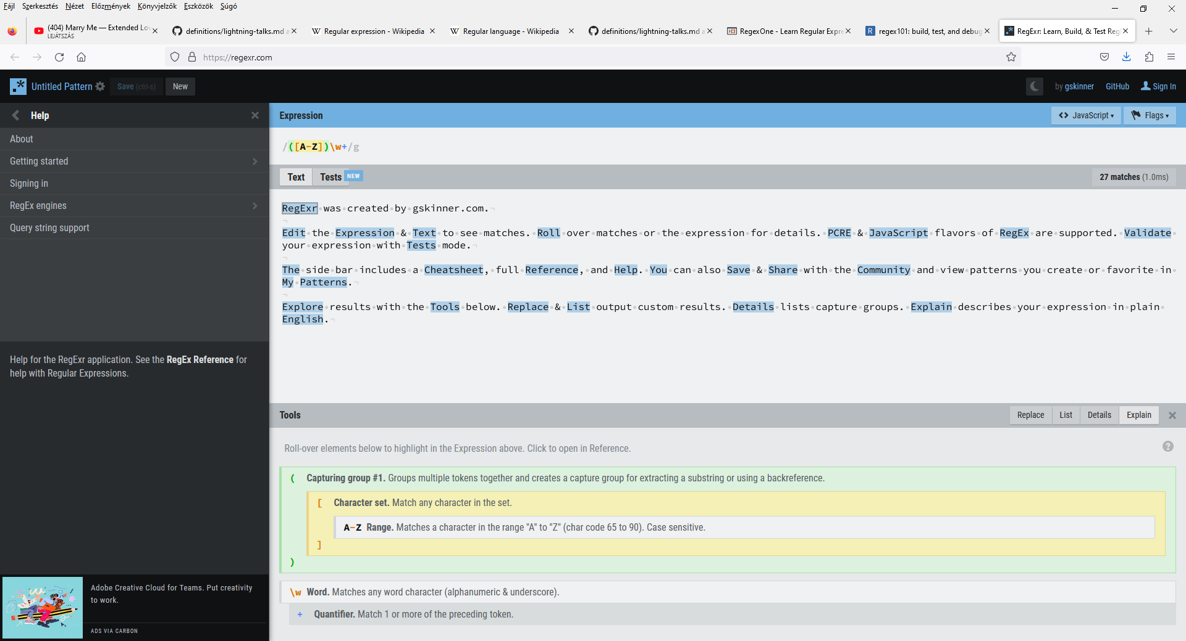
7. Education tools (3/3)
Notes:
regexr.com:
This site has abilites almost identical to regex101.com
The link to this website is available under „8. Resources (1/3)” in this presentation.

Slide 13

8. Resources (1/3)
ACCESS TO THIS PRESENTATION
https://github.com/orgs/green-fox-academy/projects/177/views/1?pane=issue&itemId=25429183
BASICS
What is regular expression?
https://en.wikipedia.org/wiki/Regular_expression
How to learn or test?
https://regexone.com/ (even: https://regexone.com/references/java)
https://regex101.com/
https://regexr.com/
https://www.regextester.com/
SYNTAXES (unfortunately in plural)
POSIX syntax:
https://en.wikibooks.org/wiki/Regular_Expressions/POSIX_Basic_Regular_Expressions
Perl syntax:
https://en.wikibooks.org/wiki/Regular_Expressions/Perl-Compatible_Regular_Expressions
https://perldoc.perl.org/perlre
https://www.tutorialspoint.com/perl/perl_regular_expressions.htm
POSIX flavour vs Perl favour:
https://www.baeldung.com/linux/bre-ere-pcre-syntax
https://topic.alibabacloud.com/a/parsing-posix-vs-perl-standard-regular-expression-differences-_php-tutorial_4_86_30966984.html

Slide 14
8. Resources (2/3)
PROGRAMMING LANGUAGES
Java:
https://docs.oracle.com/javase/7/docs/api/java/util/regex/Pattern.html
https://www.w3schools.com/java/java_regex.asp
https://www.tutorialspoint.com/java/java_regular_expressions.htm
https://www.javatpoint.com/java-regex
Python:
https://docs.python.org/3/library/re.html
https://www.w3schools.com/python/python_regex.asp
R:
https://r4ds.hadley.nz/regexps.html
C:
https://www.geeksforgeeks.org/regular-expressions-in-c/
C++:
https://en.cppreference.com/w/cpp/regex

Slide 15
8. Resources (3/3)
TEXT EDITION
Microsoft:
https://learn.microsoft.com/en-us/dotnet/standard/base-types/regular-expression-language-quick-reference
Word:
Search function: https://superuser.com/questions/846646/is-there-a-way-to-search-for-a-pattern-in-a-ms-word-document
VBA macros: https://answers.microsoft.com/en-us/msoffice/forum/all/can-i-use-regex-on-word/1aac7b1a-1837-45ee-a359-0f5d620291a2
Apple:
https://developer.apple.com/documentation/swift/regex
Emacs:
https://www.gnu.org/software/emacs/manual/html_node/emacs/Regexps.html
BIG DATA
https://www.integrate.io/blog/using-regular-expressions-in-big-data/
https://towardsdatascience.com/the-utility-of-regular-expressions-in-data-science-babf94285966
https://towardsdatascience.com/regular-expressions-f3ee2213b085
https://ieeexplore.ieee.org/document/8321906
https://www.gastonsanchez.com/intro2cwd/regex.html
WEB SCRAPING
https://oxylabs.io/blog/regex-web-scraping
https://towardsdatascience.com/web-scraping-regular-expressions-and-data-visualization-doing-it-all-in-python-37a1aade7924
https://mherman.org/blog/web-scraping-with-regular-expressions/
COMPILERS
https://www.tutorialspoint.com/compiler_design/compiler_design_regular_expressions.htm

Slide 16
9. Summary
Why to use?
To find a very well defined but not very exact pattern in texts
Unavoidable in „data mining” for data mining
How to use?
^R\w{2,}\ss\w{1,6}l\sset\s\w+\s\w+.\w{2,3}\s\w{5} OR
Really small set of metacharacters and rules
Who did it?
Stephen Cole Kleene, Ken Thompson, Perl developers and Philip Hazel
When?
1951, 1968-1997
Where to learn?
User friendly apps (see Resources)

Slide 17

THANK YOU FOR YOUR ATTENTION
QUESTIONS?

